Slide 1

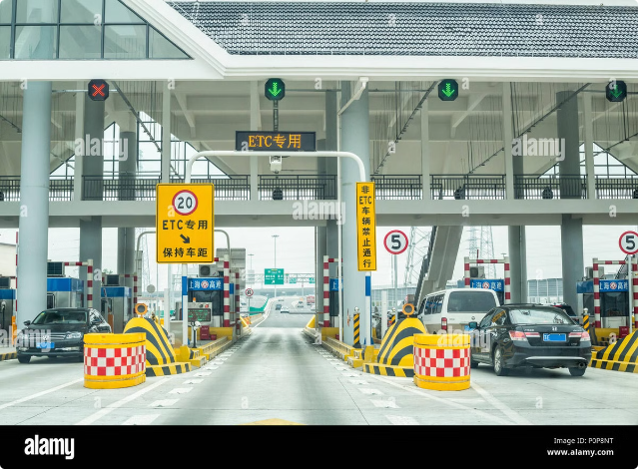

Introduction to GPS Toll-Based Simulation
This presentation introduces a innovative GPS-based toll system that uses real-time location tracking to efficiently manage traffic flow and collect fees. The system offers a seamless and automated solution for managing toll roads and bridges.

Slide 2


Problem Statement
The project aims to address the inefficiencies in current toll collection systems, such as manual payment processing and traffic congestion at toll plazas.
Challenges include integrating automated vehicle detection, accurate toll calculation based on distance and vehicle type, and seamless payment processing.

Slide 3

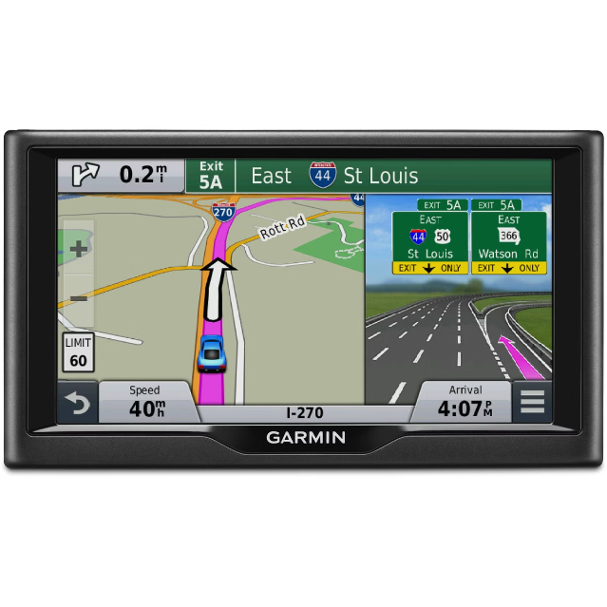
Unique Idea Brief (Solution)
Implementing a real-time GPS-based toll system that automates the process from vehicle detection to toll calculation and payment.
Leveraging computer vision for vehicle detection, geospatial calculations for distance, and a simulated payment gateway for transaction processing.

Slide 4

Features Offered
Vehicle Detection: Real-time detection of vehicles using computer vision techniques.
Distance Calculation: Accurate GPS-based distance calculation between vehicle entry and exit points.
Toll Calculation: Dynamic toll calculation based on vehicle type and distance traveled.
Payment Processing: Simulated payment gateway for automatic transaction handling.
User Interface: Web-based interface for user interaction and displaying toll information.

Slide 5
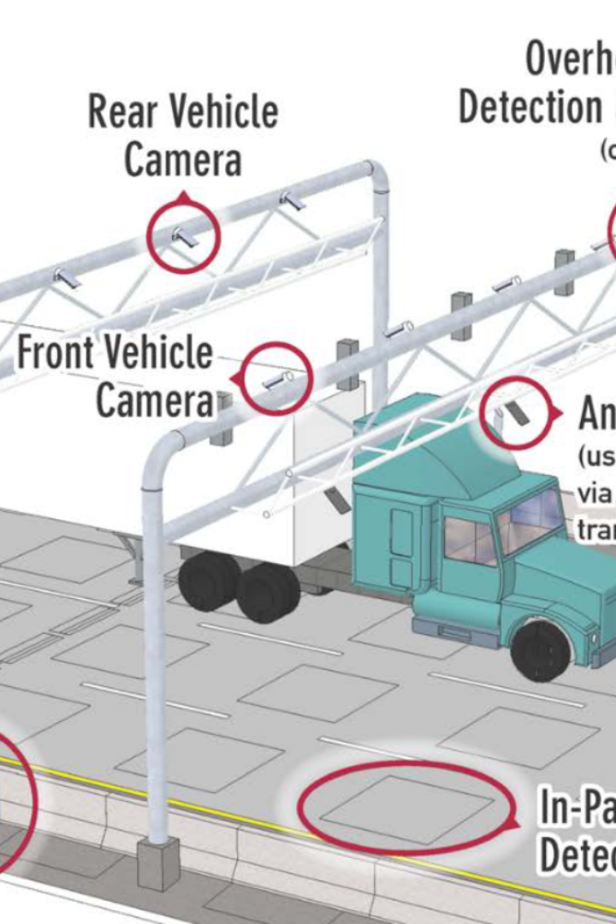
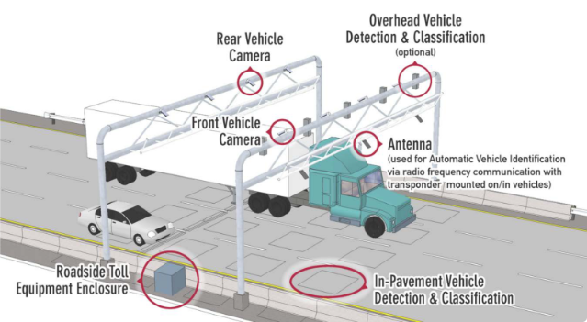
Process Flow
Vehicle Detection: Frames captured from CCTV or camera feeds are processed using OpenCV. Haar cascades or other machine learning models detect vehicles in the frames.
Distance Calculation: GPS coordinates of entry and exit points are used to calculate distance using geopy library.
Toll Calculation: Based on vehicle type and distance, toll amount is dynamically calculated using predefined rates.
Payment Processing: Simulated payment gateway verifies and processes payments for toll charges.
User Interaction: Web interface updates users with calculated toll charges and transaction status.

Slide 6
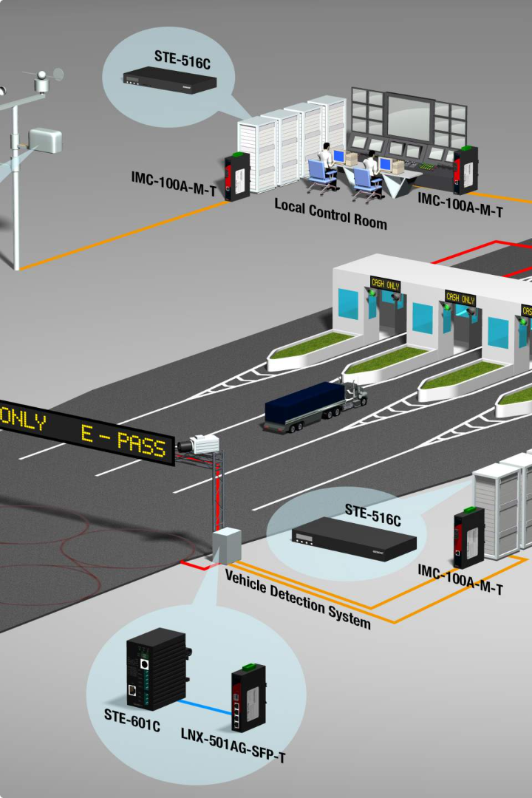
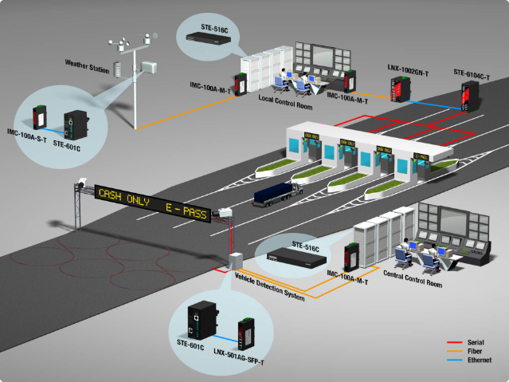
Architecture Diagram
Visual representation of the project's components and their interactions.
Components include vehicle detection module, distance calculation module, toll calculation module, payment processing module, and user interface.
Arrows denote data flow between modules and interaction with external systems (e.g., camera feeds, GPS coordinates).

Slide 7
Technologies Used
Python: Programming language for backend logic and integration of modules.
Flask: Web framework for developing the backend server and handling HTTP requests.
OpenCV: Computer vision library for vehicle detection from camera feeds.
Geopy: Python library for geospatial calculations, used for distance measurement.
HTML/CSS: Frontend development for user interface and styling.
SQLite (Optional): Database for storing transaction and user data in a prototype setup.

Slide 8






Team Members and Contribution
Pooja sree G
Mari Ganesh P
Shakthishreya Ramesh
Irfanuddin
Team Leader
Developer
PPT Designer
Project Assistant
Hashir Mohamed
Project Assistant

Slide 9


Conclusion
The GPS Toll-Based Simulation project demonstrates the feasibility of automating toll collection processes using modern technologies.
Challenges overcome include accurate vehicle detection, real-time distance calculation, and secure payment processing.
Future enhancements could include scalability for large-scale deployment, integration with cloud services for data storage, and enhancement of user interfaces for better user experience.

